Slide 1
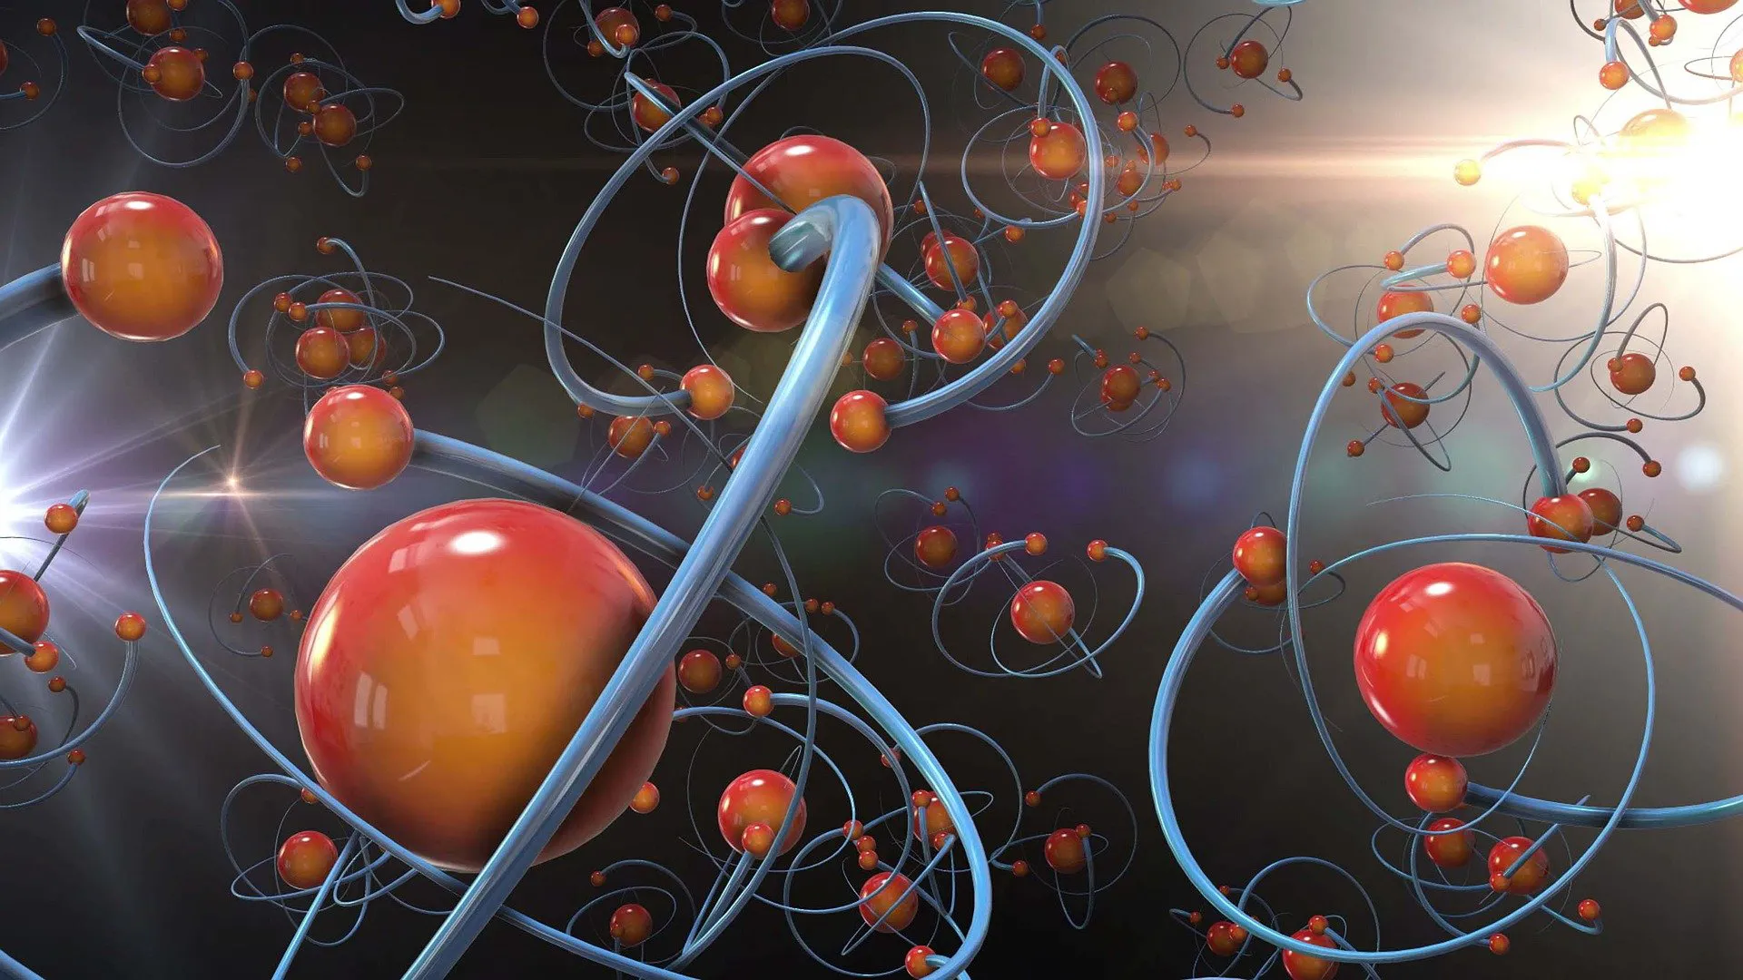
Quantum Nature of Chemical Bond
and fundamentals of Computational chemistry

Slide 2
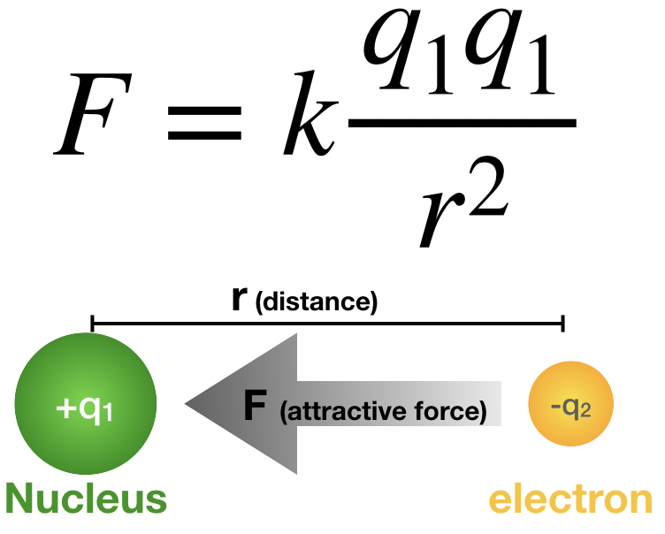

Classical View
Atoms in a molecule were held together by the mutual attraction of opposite electric charges. (Coulomb’s law/Electrostatic)
According to this view, electrons were thought to be shared between atoms in covalent bonds or transferred between atoms in ionic bonds. (Lewis Theory)
Failed??
Earnshaw’s law
Electron density map:
Density built up between the atoms from bonding, but much less than Lewis theory predicts.

Slide 3
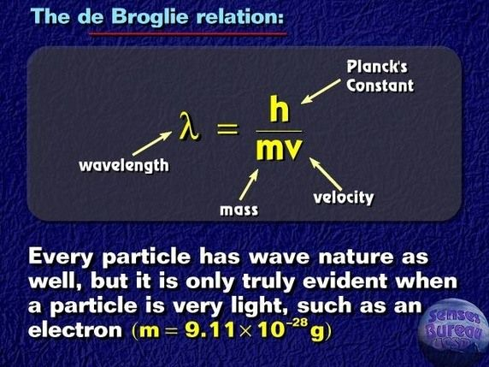

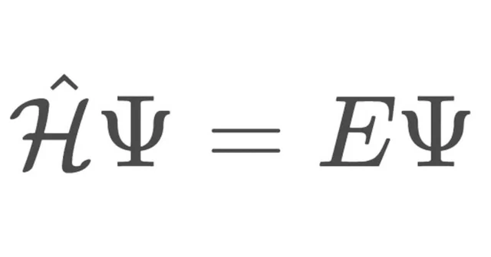
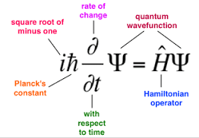
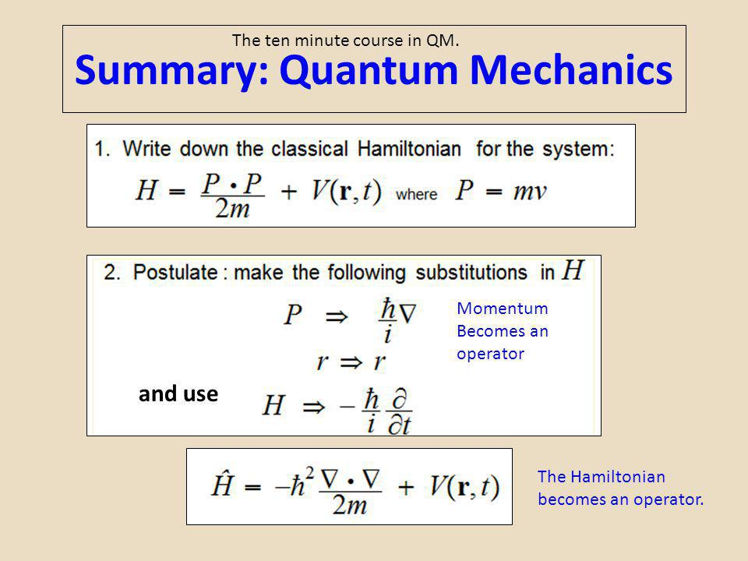
Quantum Chemical Theory

Slide 4
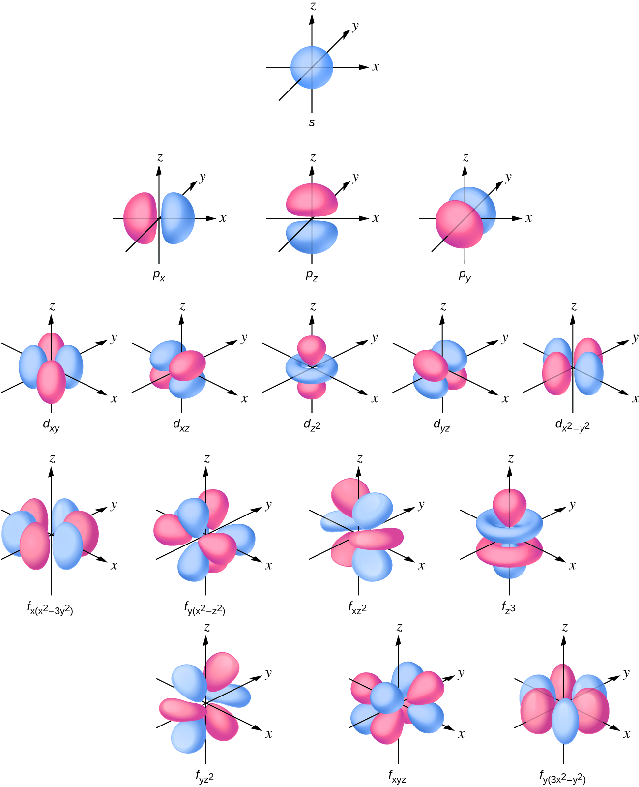
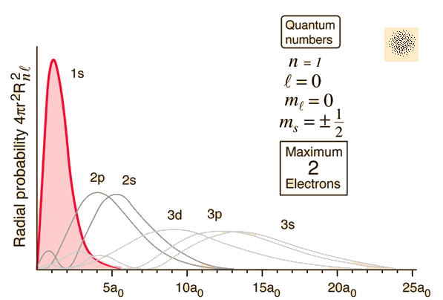
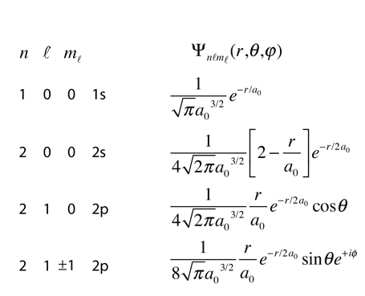
Wavefunctions and Orbital’s
Notes:
Page 129 levine

Slide 5
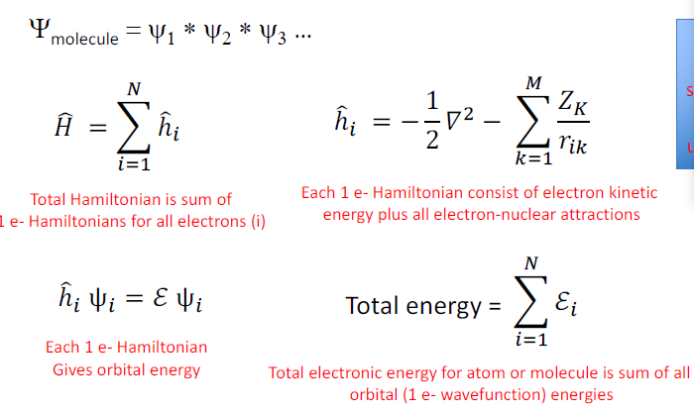
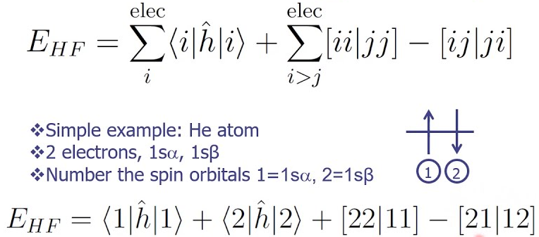
Hatree-Fock Theory

Slide 6

Quantum Explanation of Bonding

Slide 7
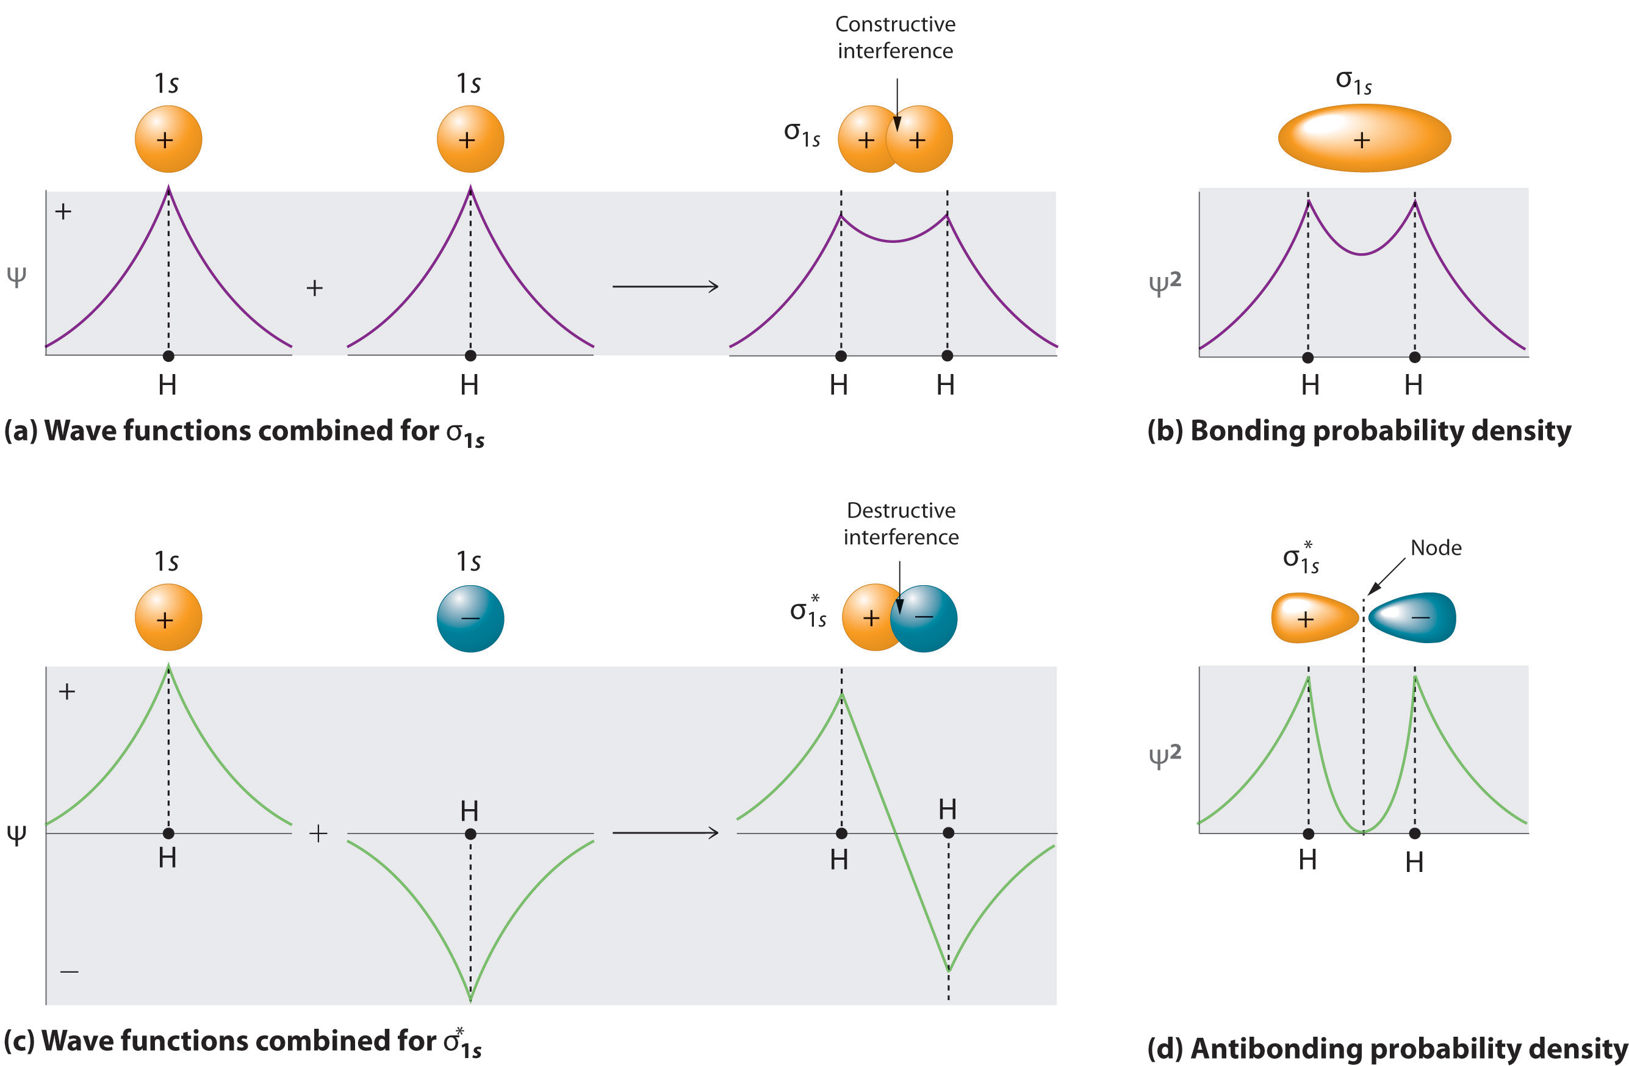
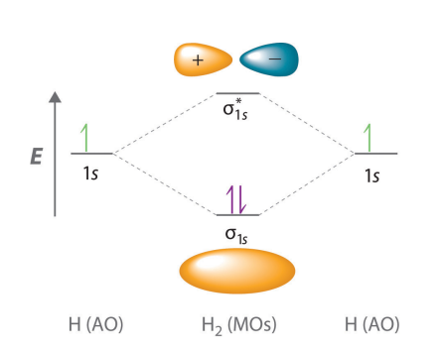
Molecular Orbital Theory

Slide 8
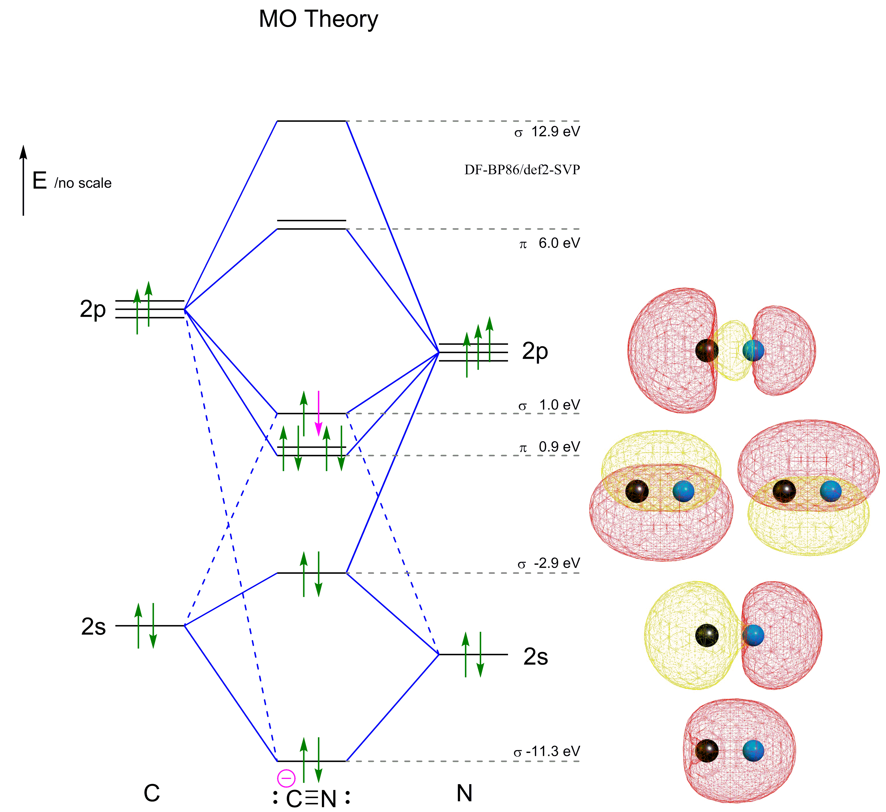
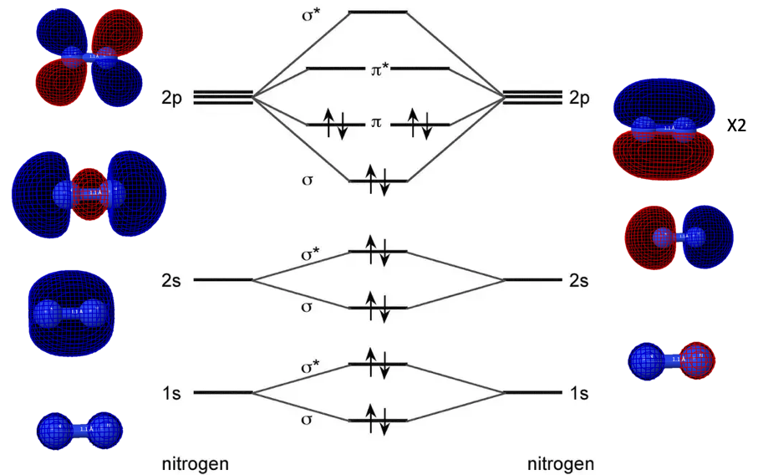

Slide 9
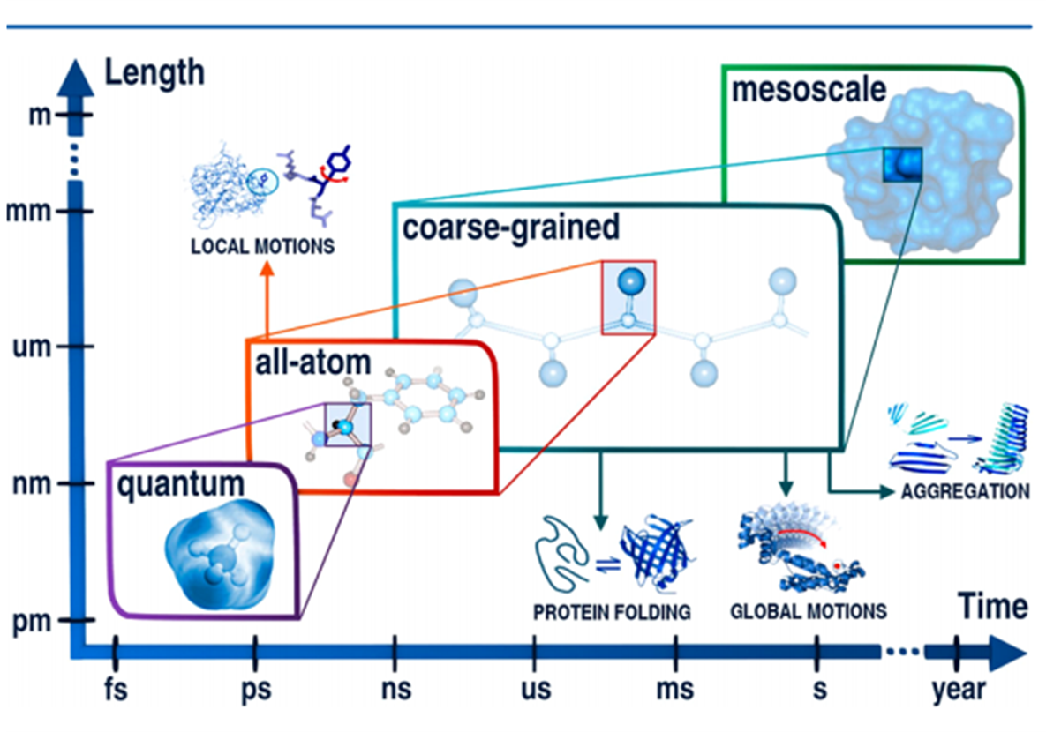

Slide 10
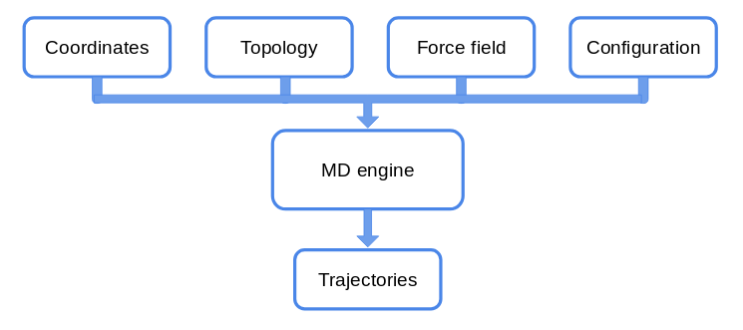
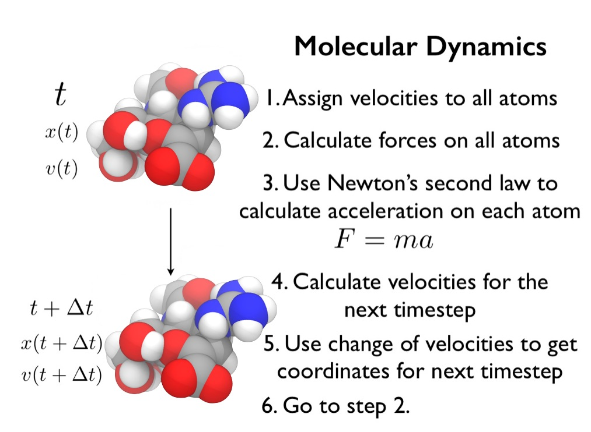
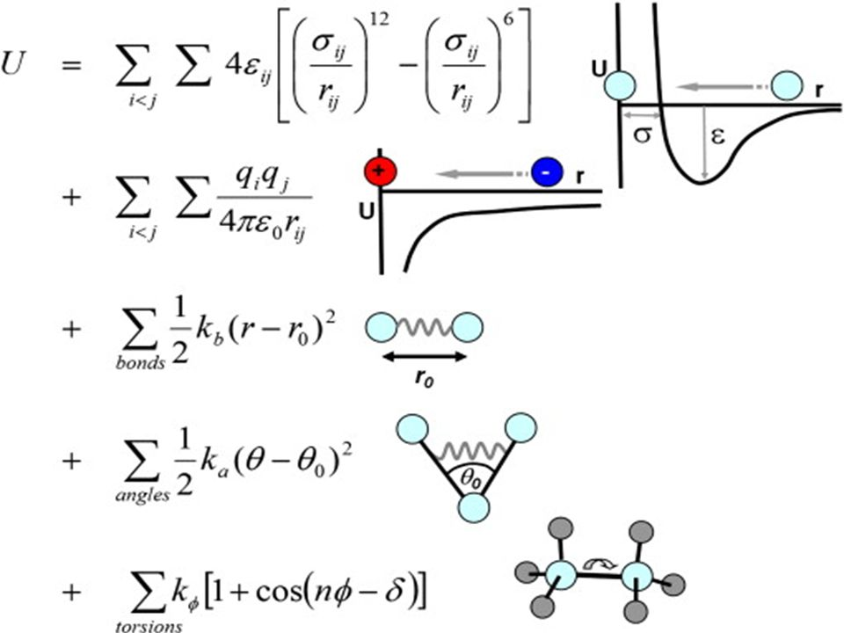
Molecular Mechanics

Slide 11
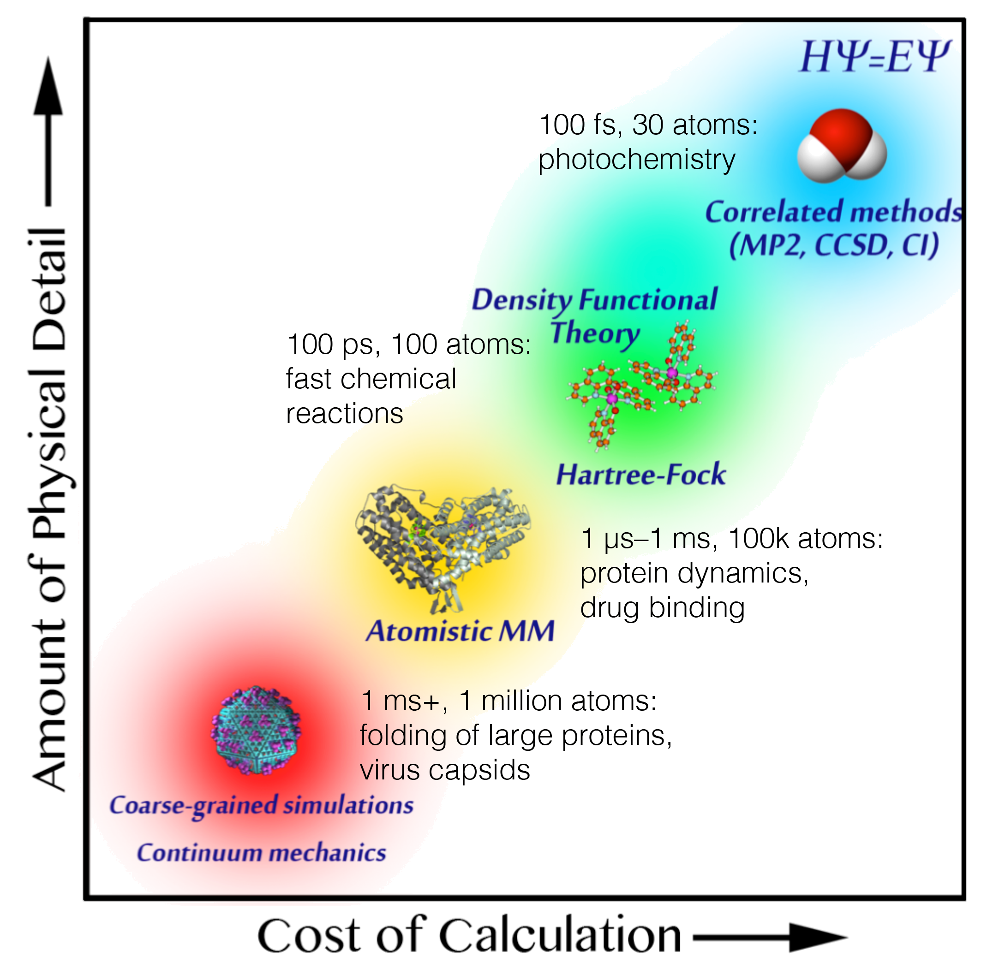
Applications

Slide 12
Dulitha Prasanna
Iowa State University
dulithaprasanna@gmail.com
dulitha@iastate.edu
https://www.linkedin.com/in/dulitha-prasanna
Fb: Ɗulitha Ƥrasaȵna
Sulalith Samarasinghe
Kansas State University
samarasinghe1995@gmail.com
sulalith@kansas.edu
Fb/Ln: Sulalith Samarasinghe
Namindu Rangana
University of Florida
nami.rangana@gmail.com
Fb/Ln: Namindu Rangana
Anyone likes to donate computational chemistry research lab , university of Colombo: PC donations program contact us.

Slide 13
Links for Software's
Gamess : https://www.msg.chem.iastate.edu/tutorials/tutorials.html
Nwchem : https://www.nwchem-sw.org/index-php/Download.html
OpenMM : https://openmm.org/
Links for codes: https://github.com/dulithaprasanna/IqLab_Podcast

